Slide 1


Welcome to
Clearmont Elementary
Miss Romano’s
4th grade

Slide 2



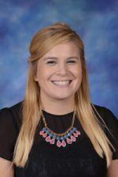
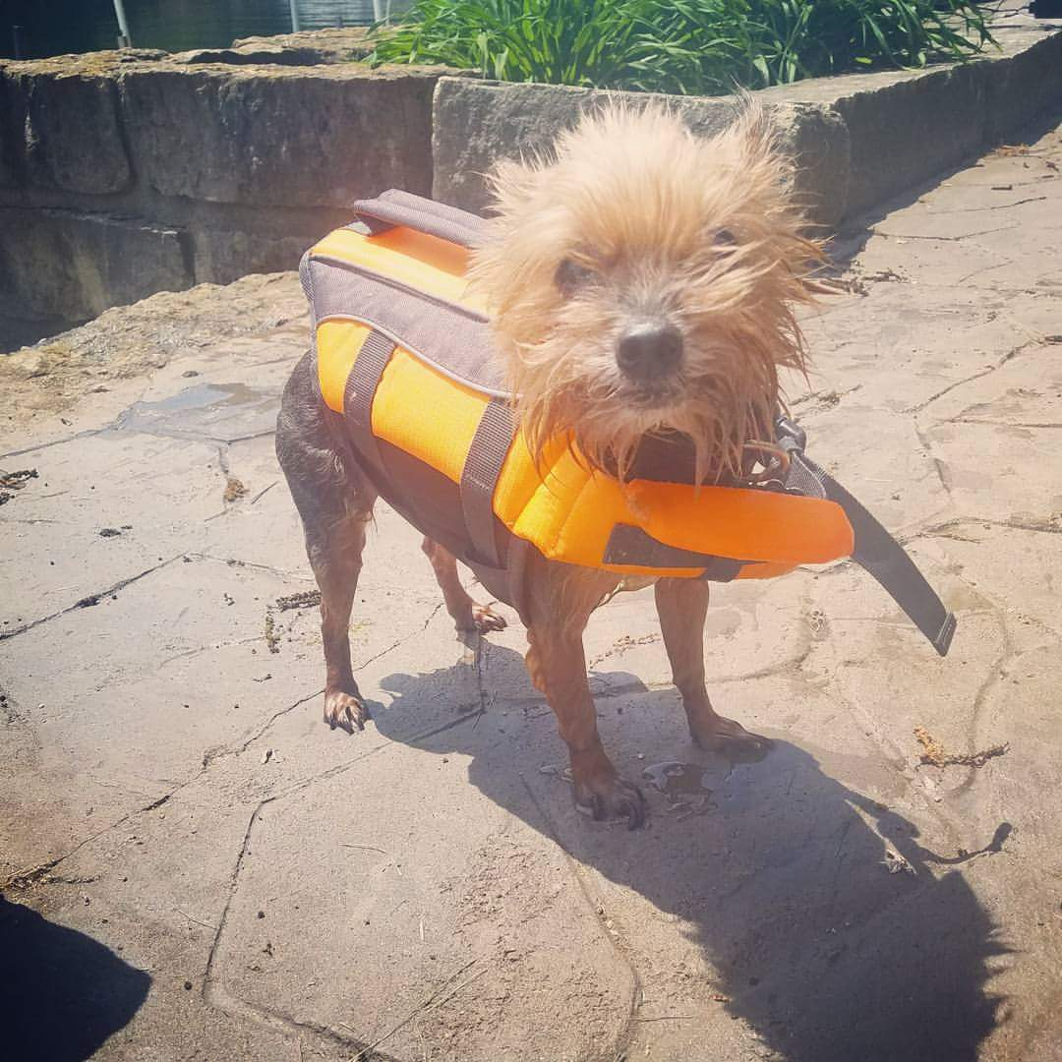


MEET THE TEACHER
Miss Mia Romano
3rd year teaching, 1st year at Clearmont!
Bachelor’s Degree in Elementary Education from DePaul University, Chicago IL
Concentration in Art
Endorsements in Social Sciences and English Language Learners
I LOVE… coffee, Target, Captain America, cheetah print, reading, running, my dog, the Chicago Cubs, and being a teacher!

Slide 3
Curriculum & Assessments

Slide 4
Curriculum: District Outcomes
Civic and Global Responsibility
Collaboration
Access, Analyze, and Apply Information
Communicate Effectively
Critical Thinking
Problem Solving
Creativity
Determination and Perseverance
Self Awareness

Slide 5
Curriculum: Workshop Model
(Reading, Writing, and Math)
Mini lesson - teacher directly teaches students by demonstrating a strategy and allowing them to have a quick try
Purposeful Practice - meaningful and authentic application and practice (independently or small groups) of the strategy from the mini lesson
Share/Reflection - class comes together to allow students to consolidate their learning by sharing and reflecting

Slide 6

Curriculum: Reading
Unit 1 - Building a Reading Life
Unit 2 - Following Characters into Meaning
Unit 3 - Navigating Complex Nonfiction: Reading the World
Unit 4 - Interpretation Text Sets: Book Clubs
Unit 5 - Exploring the Mood and Imagery in Poetry
**Also small group Guided Reading**

Slide 7

Curriculum: Writing
Unit 1 - Launching with Personal Narratives
Unit 2 - Realistic Fiction: Arc of a Story
Unit 3 - Writing Lively, Voice-Filled Information Book/Feature Article
Unit 4 - The Literary Essay
Unit 5 - Free Verse Poetry

Slide 8

Curriculum: Math
Place Value
Multiplication/Division
Fractions
Decimals
Geometry
Measurement

Slide 9

Curriculum: Science
Systems
(How things work together,
ie: “The Water Cycle”)

Slide 10

Curriculum: Social Science
Innovation
(technology, inventions/inventors & how they impact society)

Slide 11

Curriculum: Social and Emotional Learning
Daily Circles
Wednesday Lessons (flexible to the needs of each class)

Slide 12

Assessments: Fountas and Pinnell
Individually administered - Fall and Spring (with mid-year Winter checkpoint)
Allows teachers to get to know students as readers so they can plan meaningful instruction
Helps communicate with more clarity about a child’s reading level and instructional needs
Determines literacy strengths
Results and Parent Tips available at Goal Setting Conference

Slide 13

Assessments: FAST Test
FAST - Formative Assessment System for Teachers
Computer Based Test
Self-Adjusting
Aligned to Common Core State Standards and assesses a student’s reading and math skills
Administered to all students Fall, Winter, and Spring.
Parents will receive results at Goal Setting Conference

Slide 14
Classroom Information

Slide 15
Schedule (M, T, Th, F)
8:45-9:00 - Social Emotional Learning
9:00-9:45 - Science/Social Science
9:45-10:25 - Specials (LRC, Art/Music, PE)
10:25-11:45 - Math
11:45-12:35 - Recess/Lunch
12:35-3:15 - Literacy (Writer’s Workshop, Guided Reading, Reader’s Workshop)
3:15-3:25 - Social Emotional Learning
3:25-3:30 - Wrap Up/Dismissal

Slide 16
Schedule (Wednesday)
8:45-9:45 - Social Emotional Learning
9:45-10:30 - Science/Social Science
10:30-11:45 - Math
11:45-12:35 - Lunch/Recess
12:35-2:15 - Literacy (Writer’s Workshop, Guided Reading, Reader’s Workshop)
2:15-2:25 - Social Emotional Learning
2:25-2:35 - Wrap Up (One Hour Early Dismissal every Wednesday)
**Every third Wednesday will be a “Wacky Wednesday.”

Slide 17
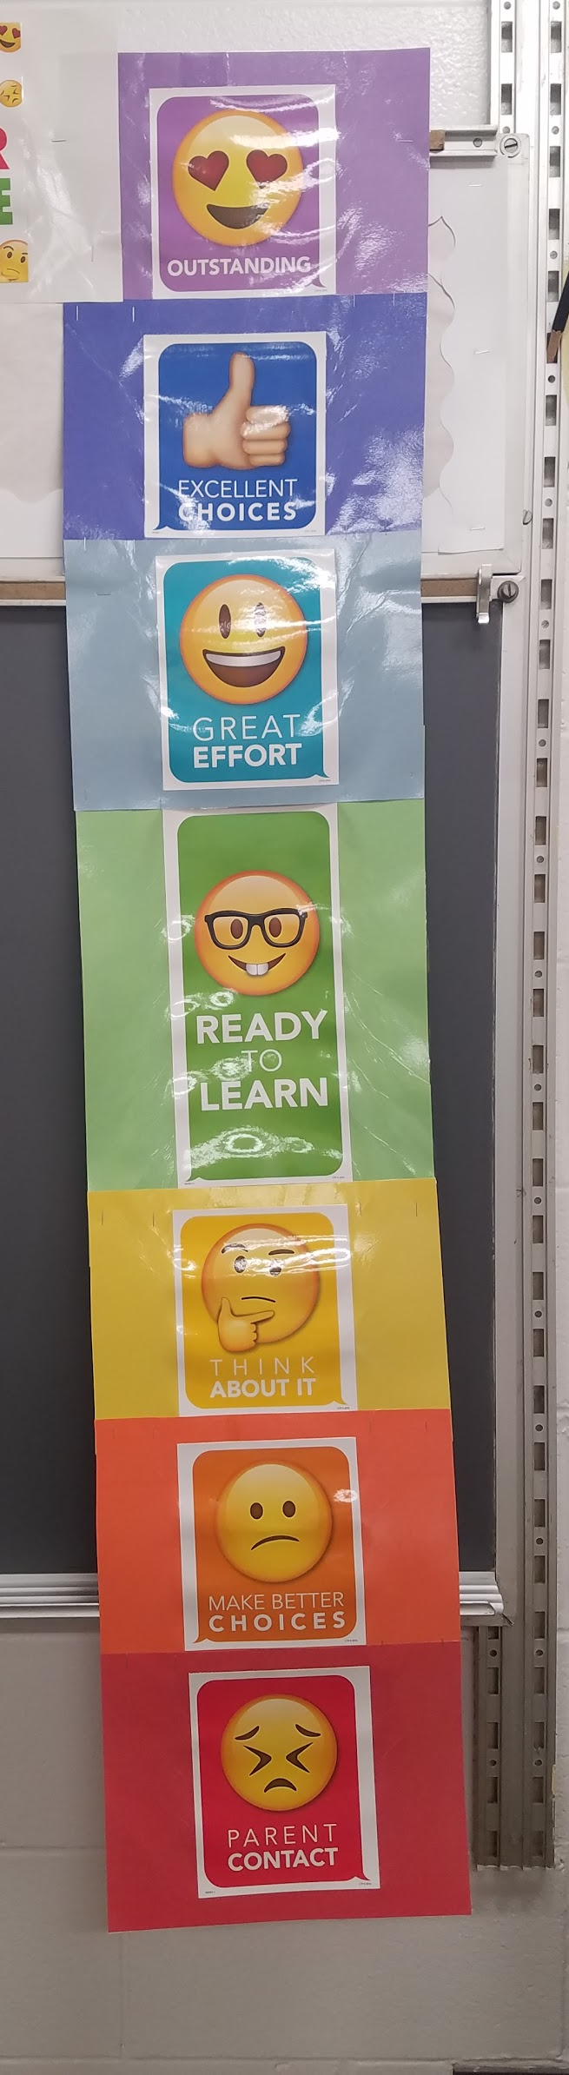
Behavior Expectations
SOAR (Safety, Ownership, Attitude, Ready)
Behavior Clip Chart
  SOAR coupons given each time a child moves “up” (to be spent at the school store)
  “Little Treasure Chest” prize for reaching “Outstanding” (purple)
  “Big Treasure Chest” prize for 10 positive days
Behavior Referrals/Parent Contact for reaching red

Slide 18
Homework
Homework will be assigned Monday-Thursday. Students will receive reading, math, and spelling homework.
Students will have a home folder. In this folder they will write their assignments and bring home all materials needed for their assignments, as well as all of their “mail.”
Students are expected to turn in homework on time everyday. If a pattern of missing or late assignments develops, you will be notified.

Slide 19

Homework Expectations
Reading
  Students will be expected to read every night.
  Students will be expected to respond to their independent reading in their Reading Notebooks.
Math
  Facts should be practiced EVERY night. Students can choose how to practice their facts, but I highly recommend if possible.
  Students will usually receive a math worksheet on Mondays and Wednesdays.
Spelling
  Contract due Friday
  Spelling Test on Friday

Slide 20

COOL KID OF THE WEEK (STAR STUDENT)
Each student will have one week this year to be the “Cool Kid of the Week”
This is a week for your child to be celebrated!
The focus is also to be a “star” role model and demonstrate qualities we want kids to embrace such as kindness, compassion, responsibility, and making a difference.
School/Home activities and assignments - stay tuned! :)

Slide 21


Device Use in the Classroom
Devices will be used daily as a learning tool.
  Research
  Presentations
  Math (IXL, xtramath, tenmarks)
Students are expected to use their devices responsibly.
Students are expected to charge their devices at home each night.
Notes:
This slide will allow teachers to describe how they personally use the devices

Slide 22
Additional Information
Students are allowed to bring water bottles to school to have in the classroom. Please make sure it is filled with water only and tightly secured to prevent spills.
Students may NOT bring edible birthday treats, but they may bring items such as pencils or stickers to share with classmates!
Breakfast is being offered to students through their meal account. Breakfast begins before school at 8:25.
All breakfast/lunch money should be turned in to the office in the morning.
Consider joining the PTO - more information to come soon!
Notes:
This slide will allow teachers to describe how they personally use the devices

Slide 23
Fall Goal Setting Conferences
Wednesday, Oct. 4 (School in Session)
  Times 3:45 – 7:45 PM
Thursday, Oct. 5 (No school)
  Times - 12:00 - 3:00 and 4:00 - 8:00
Please be sure to sign up for a conference time before you leave!
No student attendance on Thursday, Oct 5, Friday, Oct. 6 due to Conferences
No student attendance on Monday, Oct. 9 due to Columbus Day

Slide 24
communication

Slide 25
School-Wide Communication
Clearmont Website: Clearmont.ccsd59.org
Clearmont Twitter: Clearmont_Elem
Clearmont Facebook: Clearmont Elementary School link
Clearmont Instagram: clearmontelementary

Slide 26


Connecting with Miss Romano
Monthly Newsletter sent home with class updates, pictures, and important information
Classroom Website
http://clearmont.ccsd59.org/teachers/romanomia/
Classroom Twitter:
https://twitter.com/MissRomano59
Seesaw COMING SOON!

Slide 27
Teacher Contact information
E-mail:
Romano.mia@ccsd59.org
Classroom phone:
(847) 593-4372 x3215

Slide 28
Folders/forms
First day information
Xtramath
Device contracts will go home tomorrow

